Slide 1
FOOT ULCER DETECTION
Guided By :
DR.K.LALITHA
PRESENTED By :
DEEPIKA.L(22AI010)
KAVITHA.S(22AI021)
THANISTA.S(22AI054)
TEAM NO: 8
22AIP10 - INTERNET OF THINGS AND ITS APPLICATION LABORATORY

Slide 2
Abstract
Diabetic foot ulcers affect 15% of diabetic patients and can lead to severe complications, including amputations.
To prevent this, we developed a smart insole that monitors temperature, pressure, and humidity in real-time, providing feedback to a smartphone.
This allows diabetic patients to self-monitor their feet and detect early signs of ulcer risk.
By incorporating this insole into daily footwear, patients can reduce the occurrence of foot ulcers and take preventive actions before complications arise.

Slide 3
Objectives:
To design a smart insole capable of monitoring key parameters (temperature, pressure, and humidity) related to diabetic foot ulcer formation.
To provide real-time data feedback to smartphones, enabling diabetic patients to self-monitor their foot health.
To analyze variations in monitored parameters during different activities, such as sitting and walking.
To reduce the risk of diabetic foot ulcers by enabling early detection and preventive actions.
To incorporate the smart insole into traditional footwear for diabetic patients to promote daily use and ulcer prevention.

Slide 4
Components Required:
Force Sensing Resistor(FSR)
Temperature and Humidity Sensor(DHT11)
ESP32 microcontroller
Smartphone with Bluetooth and wifi connection
Arduino IoT Cloud platform
10kohm Resistor
Jumper Wires

Slide 5
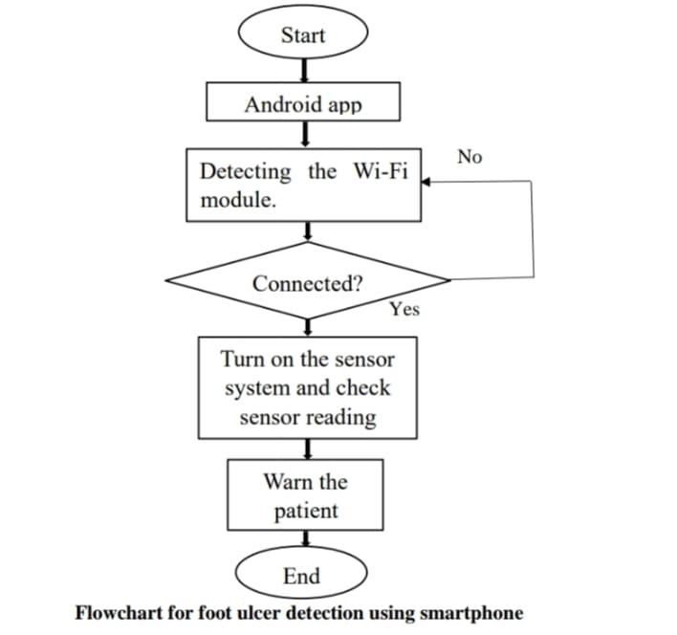
Flow Diagram:

Slide 6
Implementation: (Hardware or software)
FSR A covers the area of metatarsal and metatarsalgia.
FSR B covers the area of heel region though it covers the maximum area of three main pressure points.
By applying pressure on our foot, we get the analog signals from the sensors FSR A and FSR B.
The analog signals are transmitted to the ESP32 and It controls the output.
Temperature and humidity sensors send the analog input to the ESP32.
The analog signals are converted into digital and transmitted to the mobile app connecting to the bluetooth or Wi-Fi of our smart phone.
Acquiring the required parameters with the sensors.
Transferring the real time data to the cloud-based servers using IOT technology.
Gives instant data feedback to our smartphones and warns the patient.

Slide 7
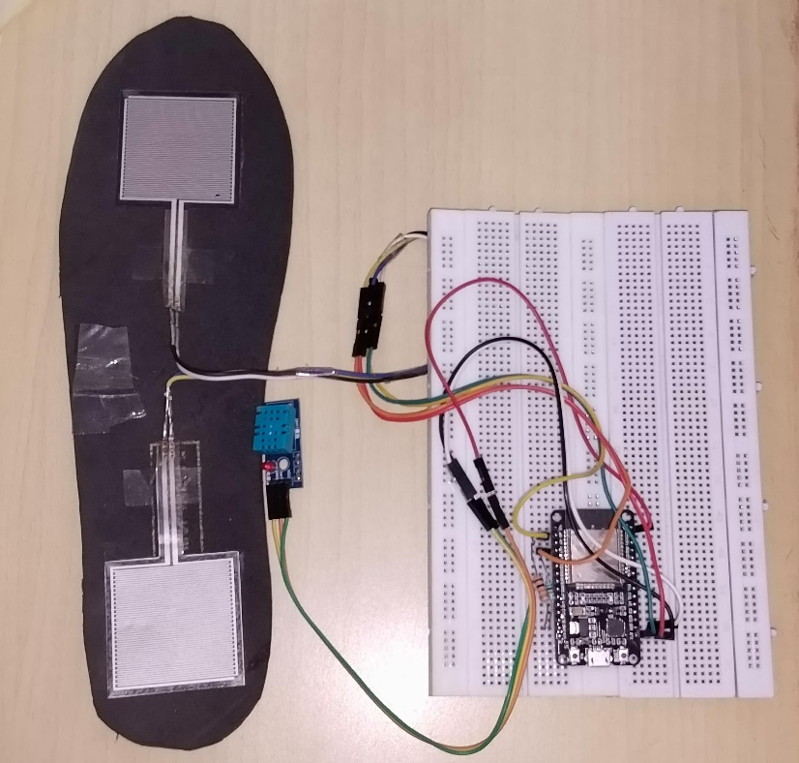
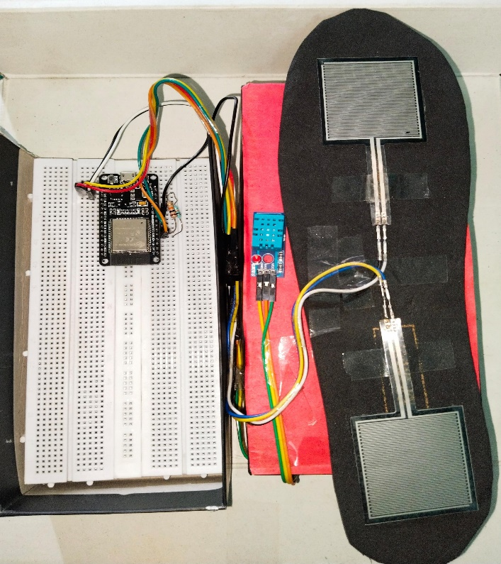
Project Photo:

Slide 8
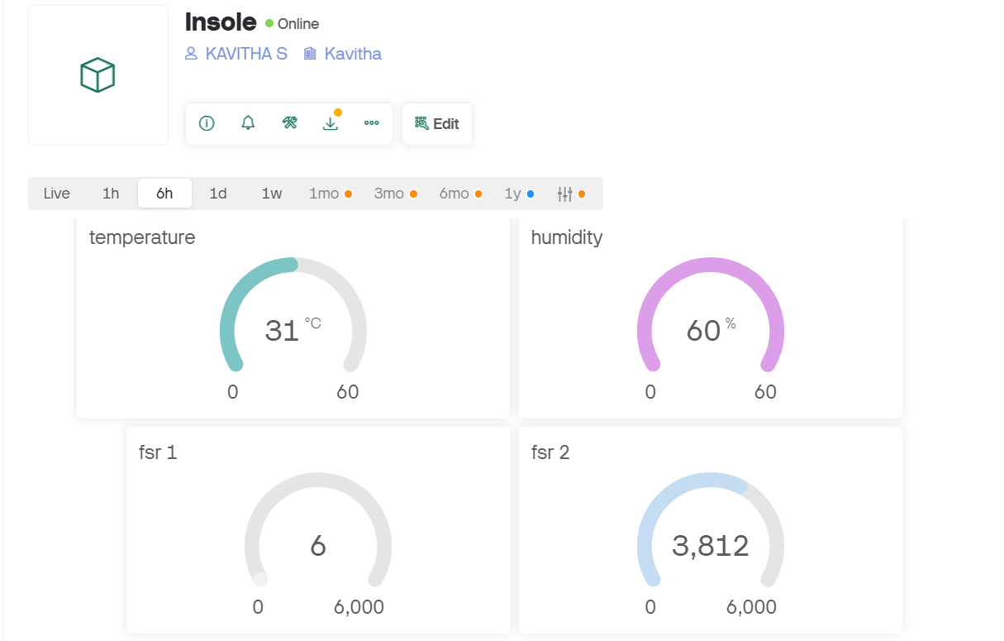
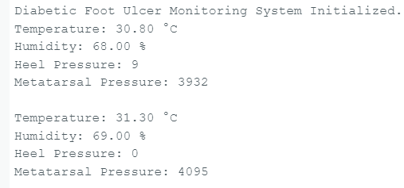
OUTPUT SCREENSHOTS:

Slide 9
Advantages:
It is light weight, thin and comfortable to wear and low cost.
It gives instant data feedback to our smart phone through Bluetooth and Wi-Fi module.
It measures diabetic foot pressure for early prevention of diabetic foot ulcer and analyze patient in monitoring foot pressure at critical points that have high risk of ulceration.
It is a real time and self monitoring wearable device.
Smart insole device integrates low-cost sensors.
It gives real time alert and foot self care education in improving offloading and adherence to prescribed foot wear in patients with diabetes mellitus.
It consumes low energy.
Both static and dynamic pressure can be used to measure pressure distribution of the foot under different conditions.

Slide 10
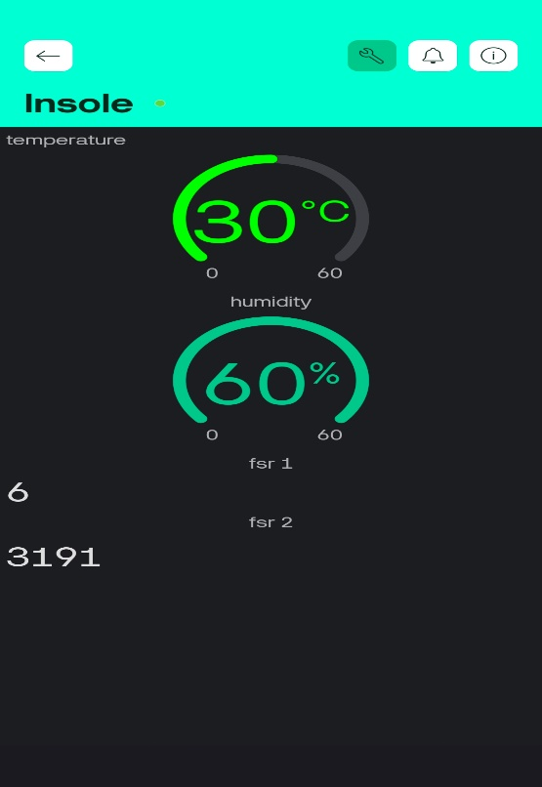
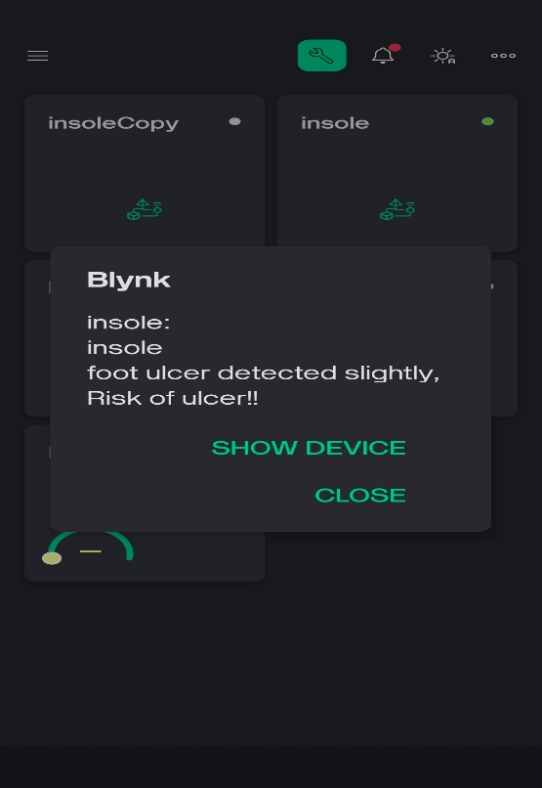
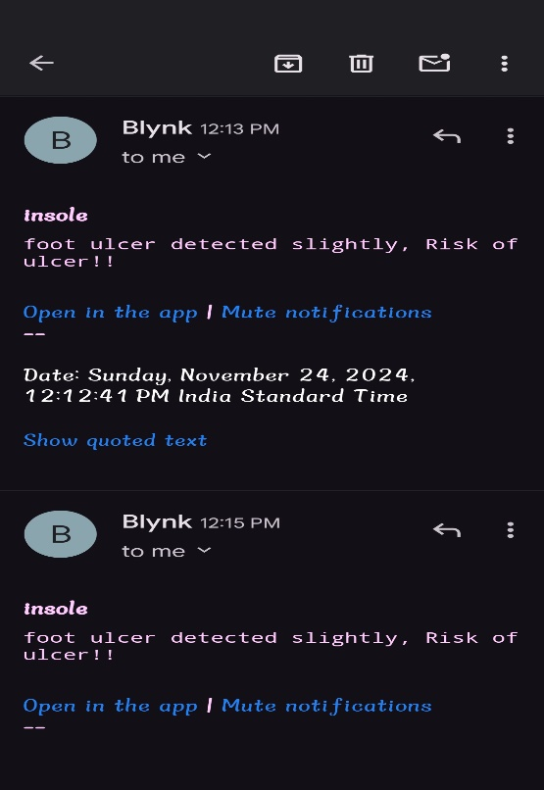
OUTPUT SCREENSHOTS:

Slide 11
Thank you

